Slide 1
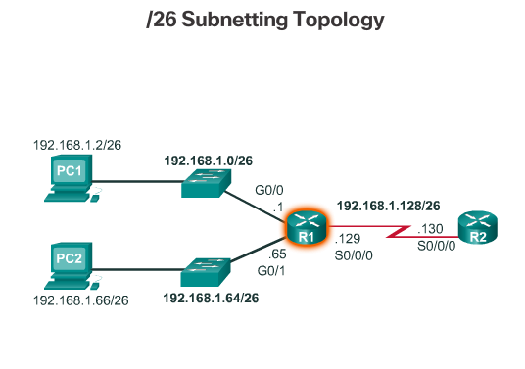
Creating 4 Subnets
Notes:
8.1.2.10 Creating 4 Subnets

Slide 2
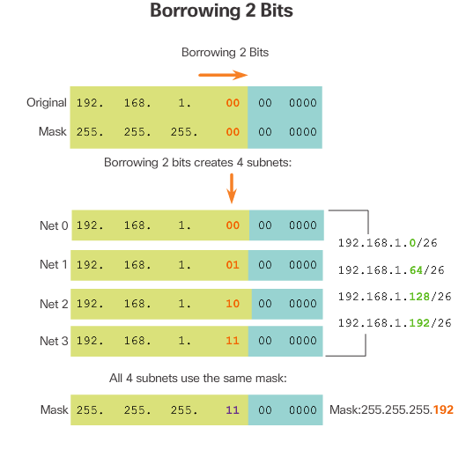
Creating 4 Subnets (cont.)
Notes:
8.1.2.10 Creating 4 Subnets (Cont.)

Slide 3
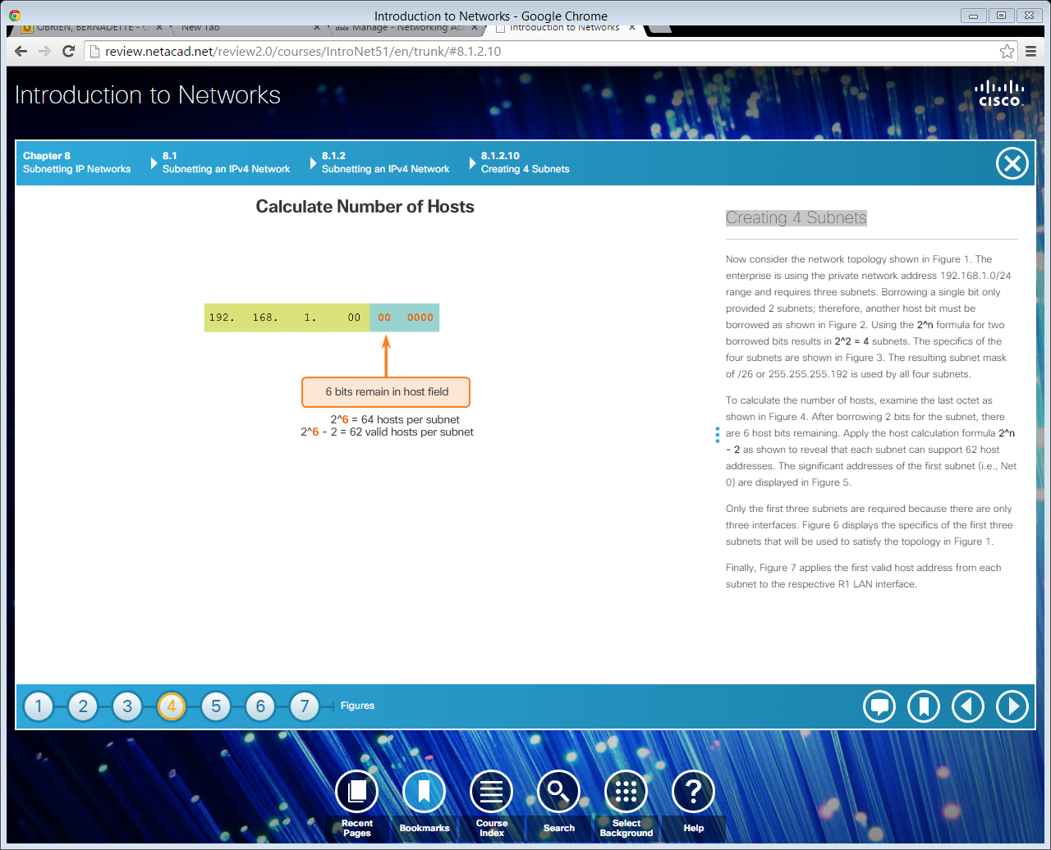
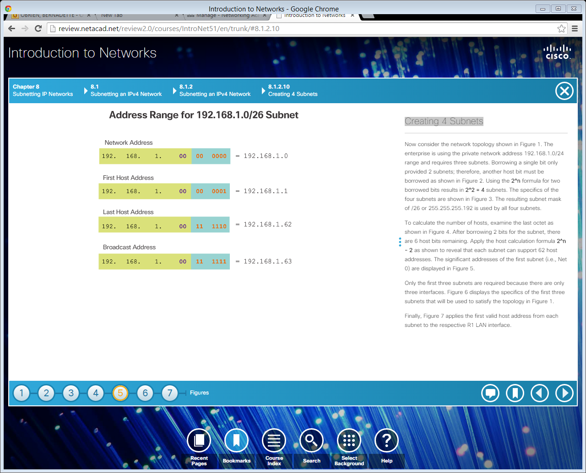
Creating 4 Subnets (cont.)
Notes:
8.1.2.10 Creating 4 Subnets (Cont.)

Slide 4
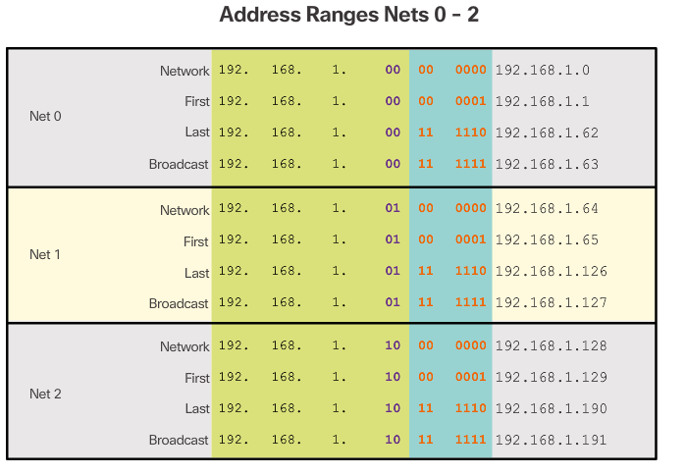
Creating 4 Subnets (cont.)
Notes:
8.1.2.10 Creating 4 Subnets (Cont.)

Slide 5
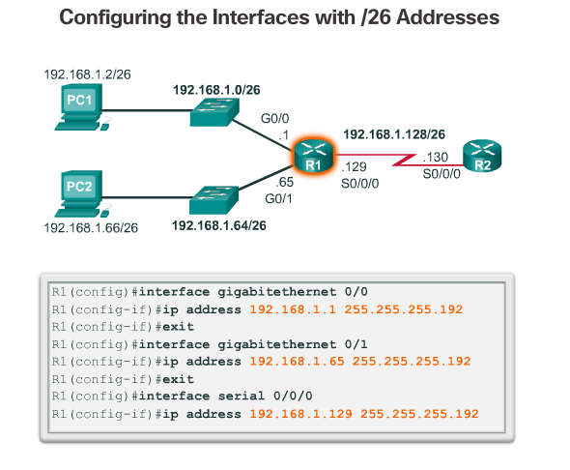
Creating 4 Subnets (cont.)
Notes:
8.1.2.10 Creating 4 Subnets (Cont.)
8.1.2.11 Video Demonstration – Creating Four Equal-Sized Subnets
8.1.2.12 Video Demonstration – Creating Eight Equal-Sized Subnets

Slide 6
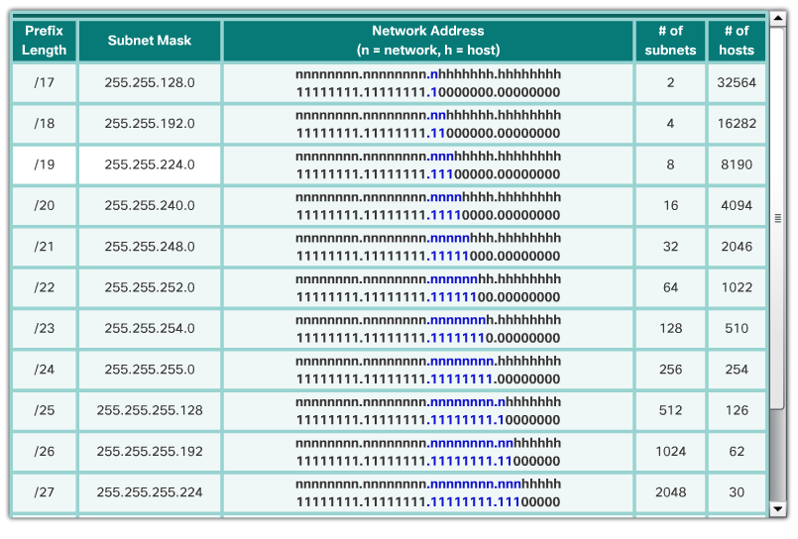
Creating Subnets with a /16 prefix
Notes:
8.1.3.1 Creating Subnets with a /16 prefix

Slide 7
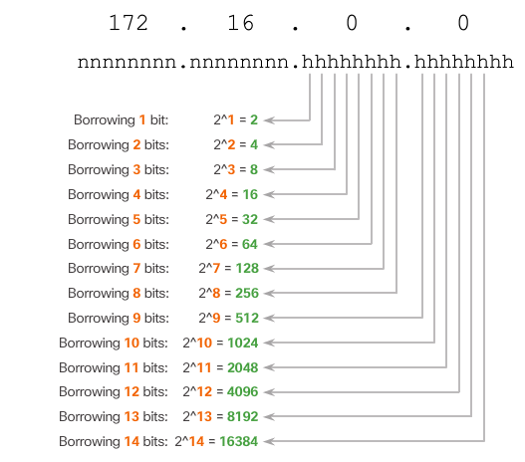
Creating 100 Subnets with a /16 Network
Notes:
8.1.3.2 Creating 100 Subnets with a /16 Network

Slide 8
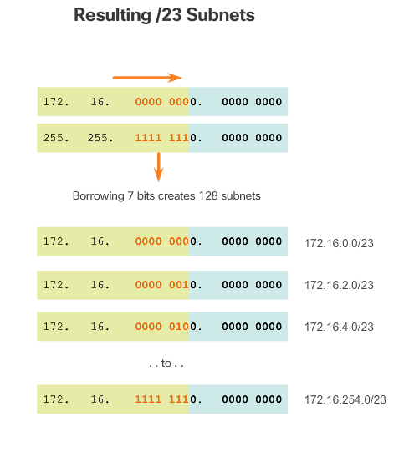
Creating 100 Subnets with a /16 Network (cont.)
Notes:
8.1.3.2 Creating 100 Subnets with a /16 Network

Slide 9
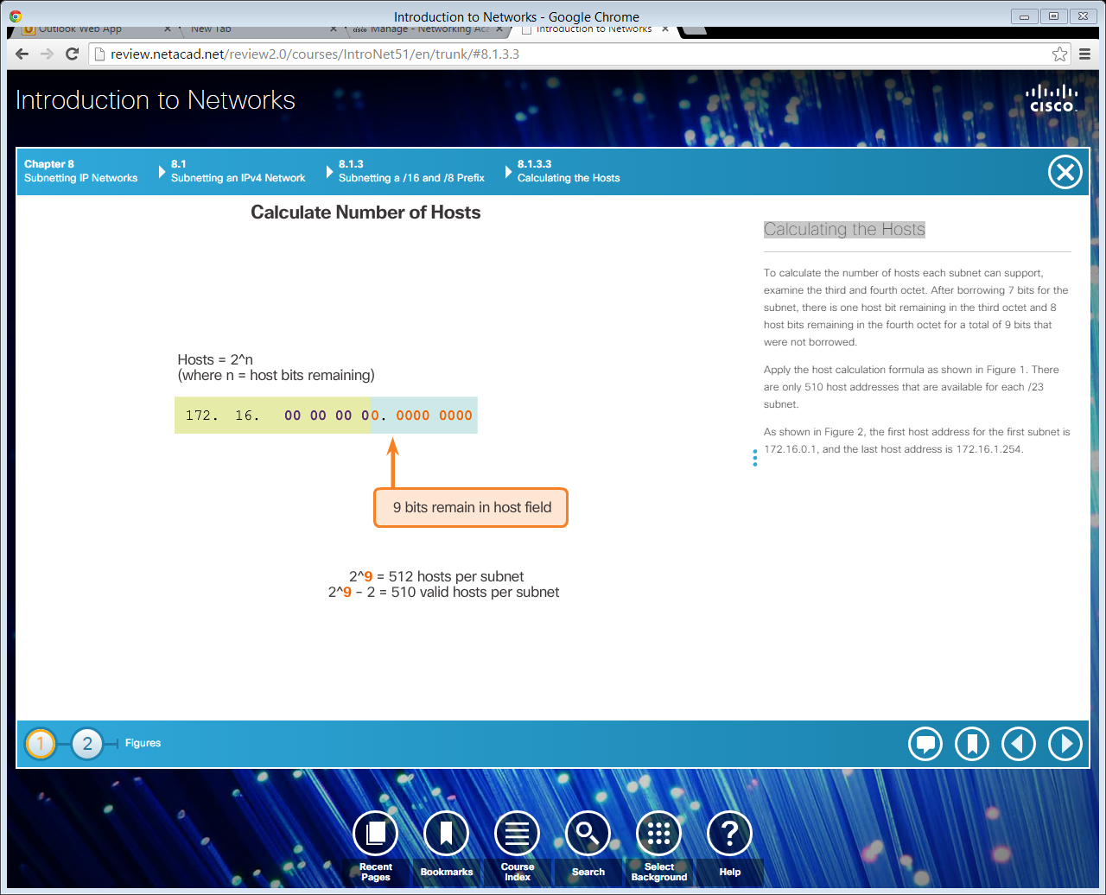
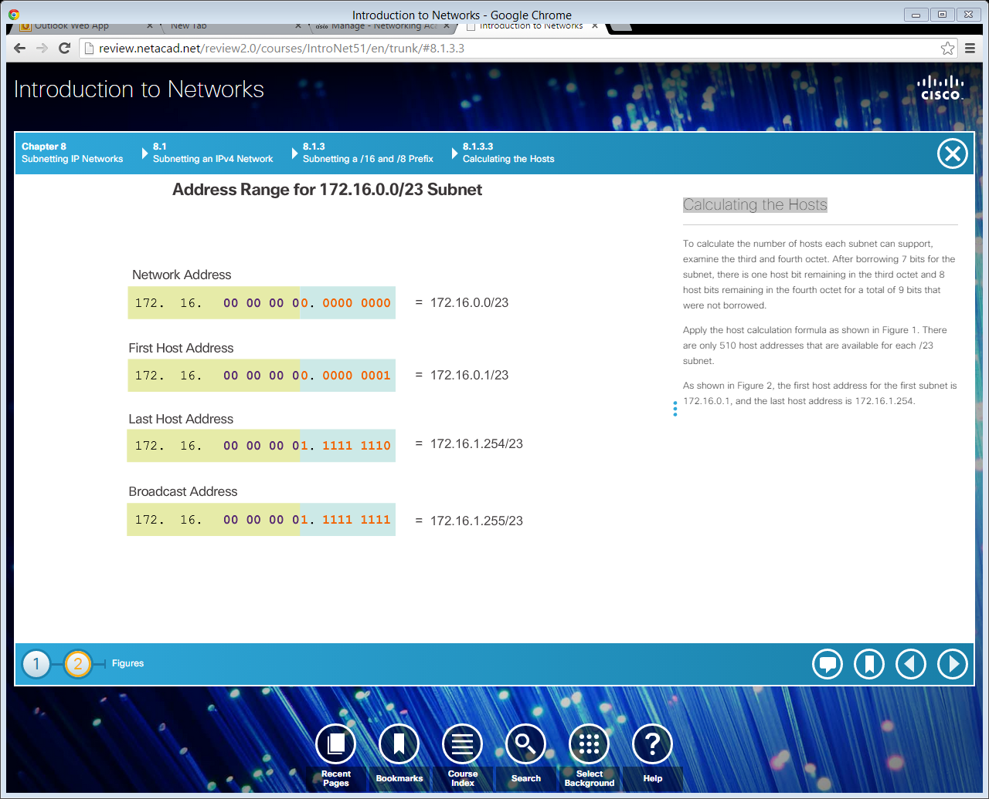
Calculating the Hosts
Notes:
8.1.3.3 Calculating the Hosts
8.1.3.4 Video Demonstration – Creating One Hundred Equal-Sized Subnets

Slide 10
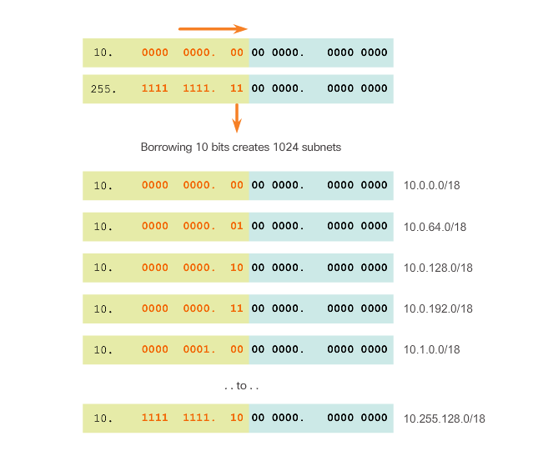
Creating 1000 Subnets with a /8 Network
Notes:
8.1.3.5 Creating 1000 Subnets with a /8 Network

Slide 11
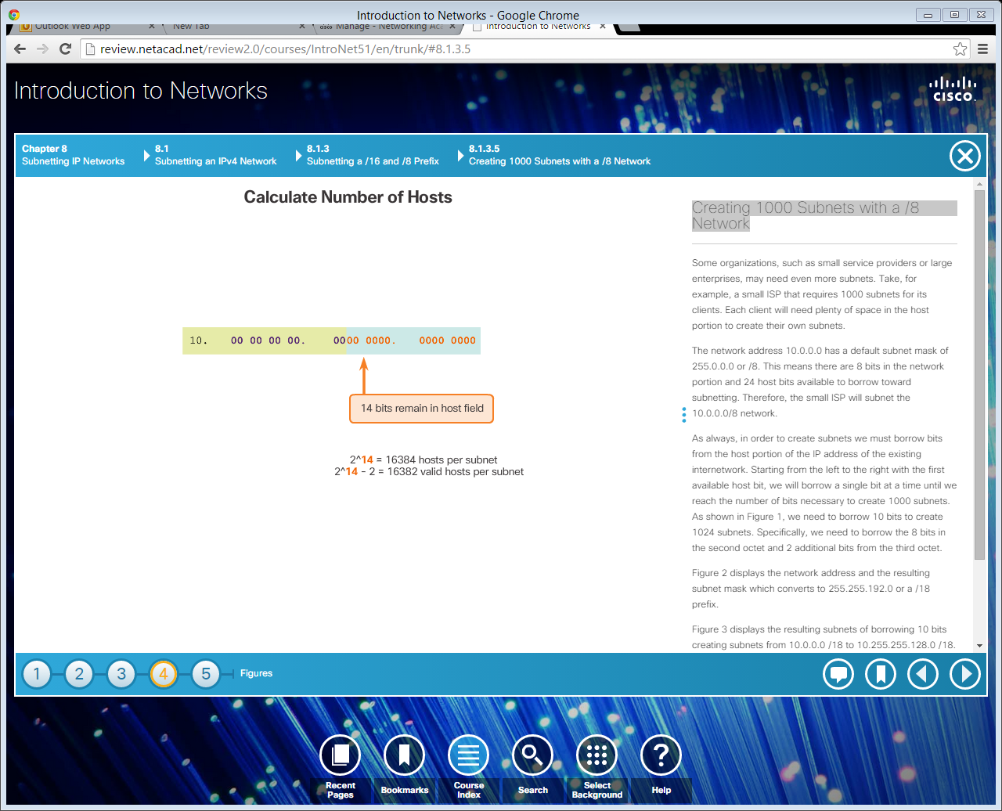
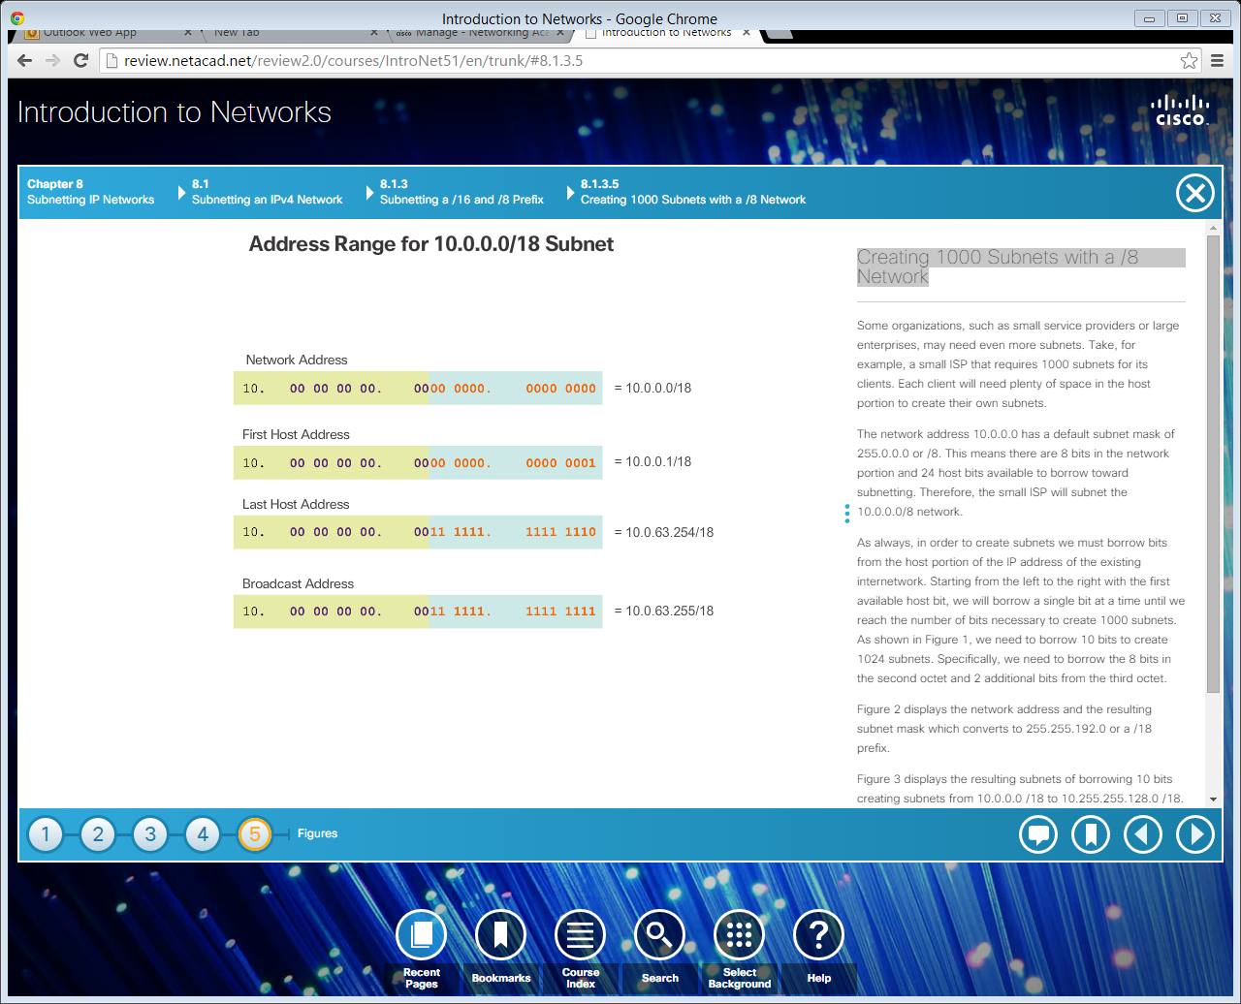
Creating 1000 Subnets with a /8 Network (cont.)
Calculating Hosts
Notes:
8.1.3.5 Creating 1000 Subnets with a /8 Network (Cont.)
8.1.3.6 Video Demonstration – Subnetting Across Multiple Octets

Slide 12
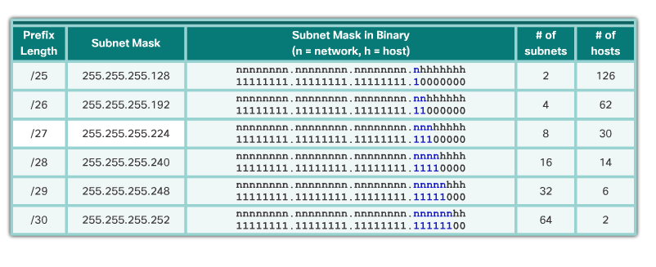
Subnetting Based on Host Requirements
Two considerations when planning subnets:
The number of host addresses required for each network.
The number of individual subnets needed.
The more bits borrowed to create subnets, the fewer host bits available.
Notes:
8.1.4.1 Subnetting Based on Host Requirements

Slide 13
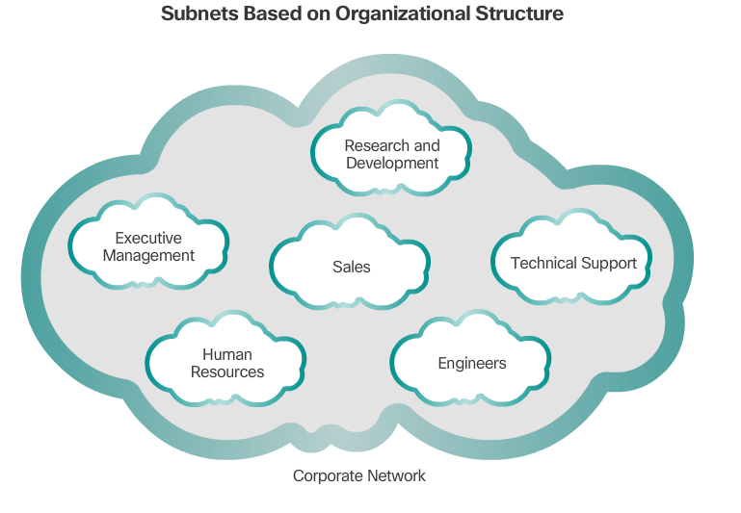
Subnetting Based on Network Requirements
Notes:
8.1.4.2 Subnetting Based on Network Requirements

Slide 14
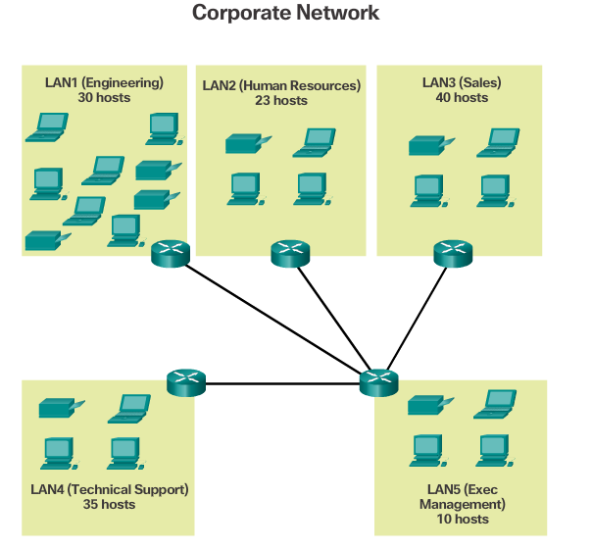
Network Requirement Example
Notes:
8.1.4.3 Network Requirement Example

Slide 15
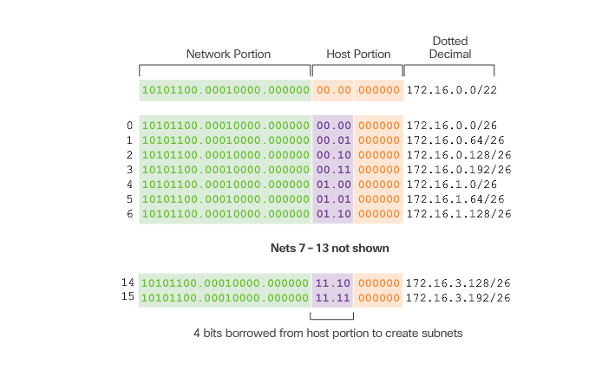
Network Requirement Example (cont.)
Notes:
8.1.4.3 Network Requirement Example (Cont.)

Slide 16
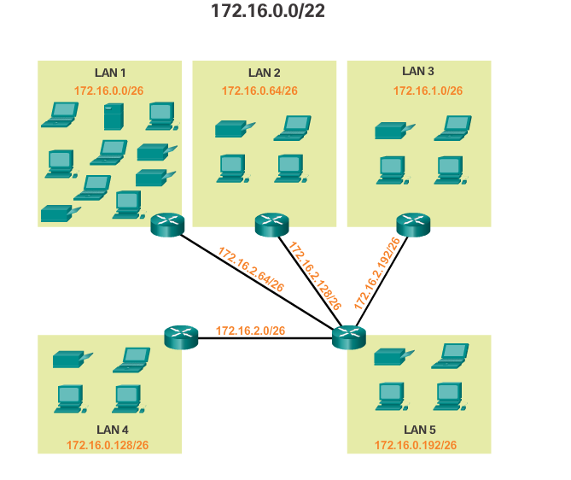
Network Requirement Example (cont.)
Notes:
8.1.4.3 Network Requirement Example (Cont.)
8.1.4.4 Activity – Calculate the Subnet Mask
8.1.4.5 Activity – Determining the Number of Bits to Borrow
8.1.4.6 Lab - Calculating IPv4 Subnets
8.1.4.7 Packet Tracer - Subnetting Scenario 1
8.1.4.8 Lab – Designing and Implementing a Subnetted IPv4 Addressing Scheme

Slide 17
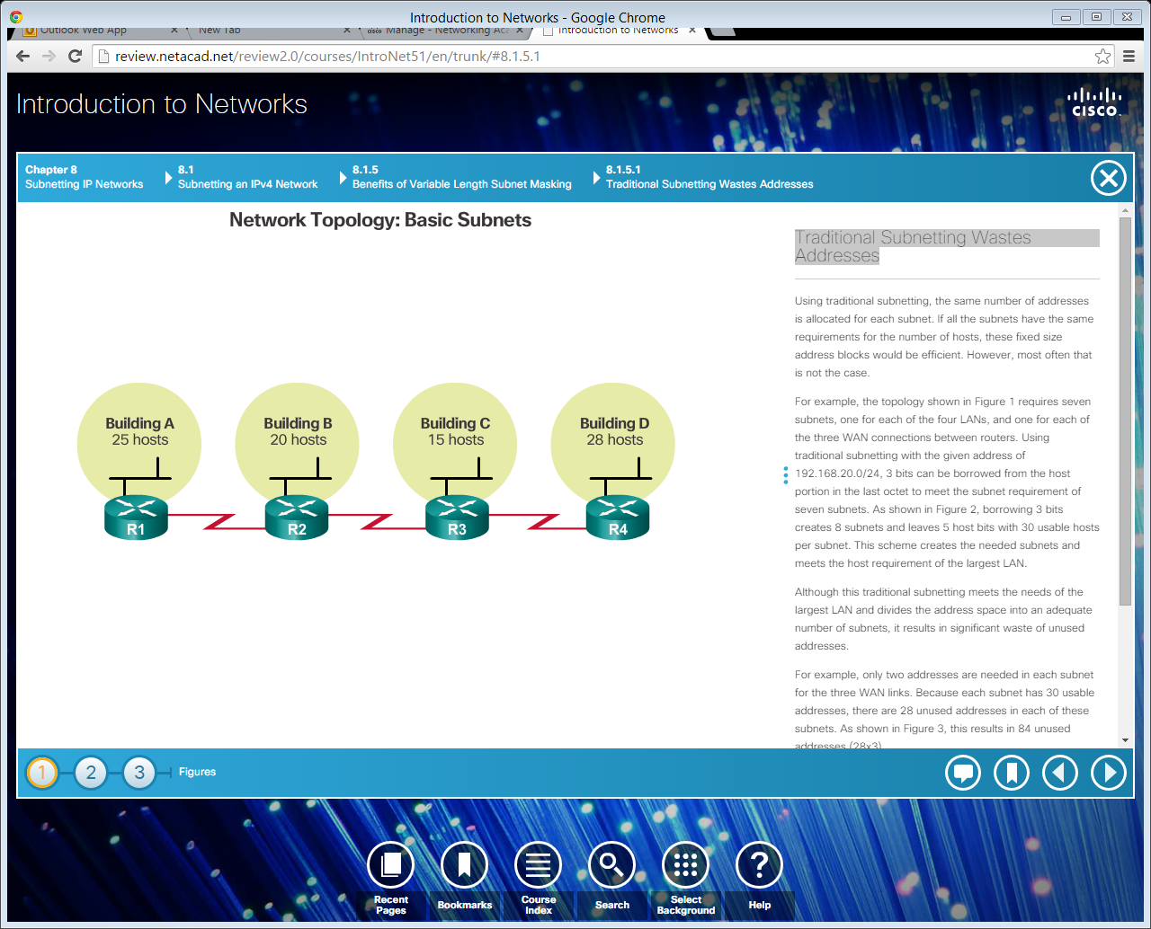
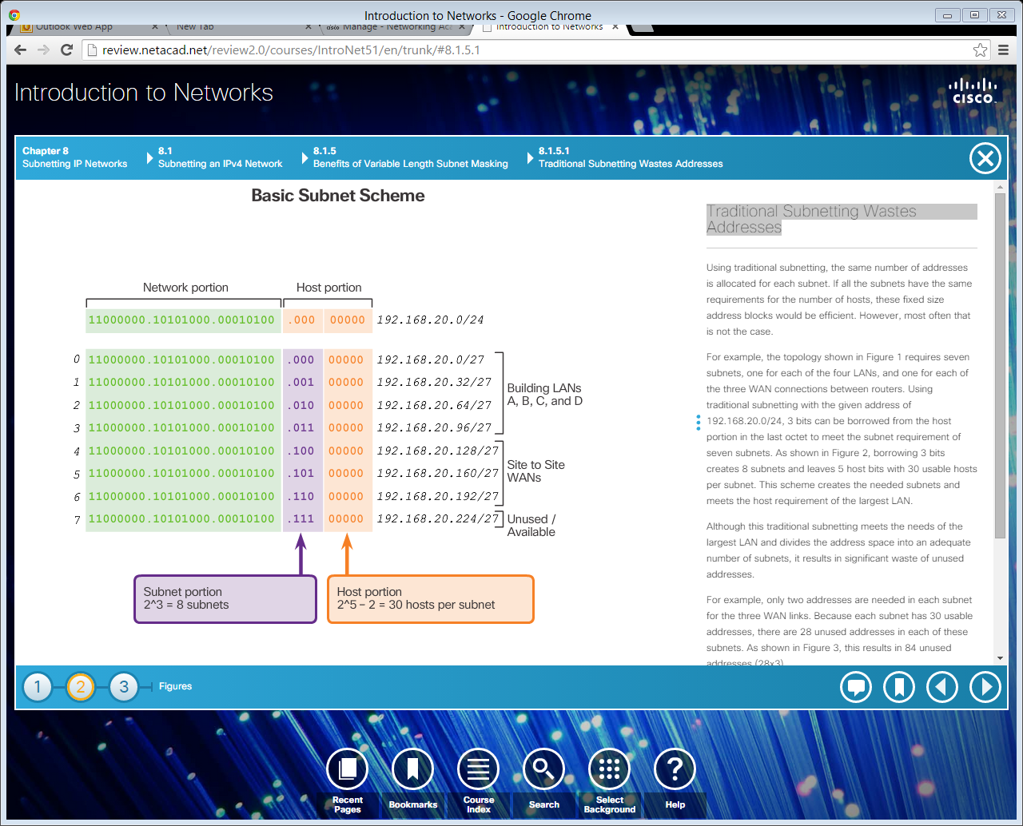
Traditional Subnetting Wastes Addresses
Notes:
8.1.5.1 Traditional Subnetting Wastes Addresses

Slide 18
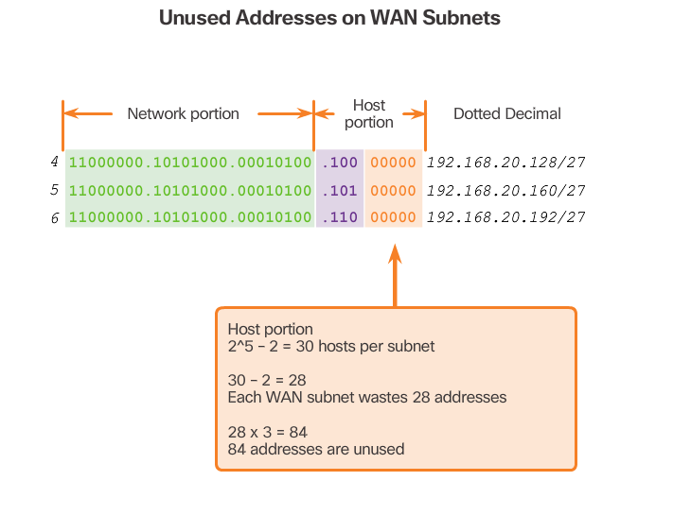
Traditional Subnetting Wastes Addresses (Cont.)
Notes:
8.1.5.1 Traditional Subnetting Wastes Addresses (Cont.)

